Slide 1
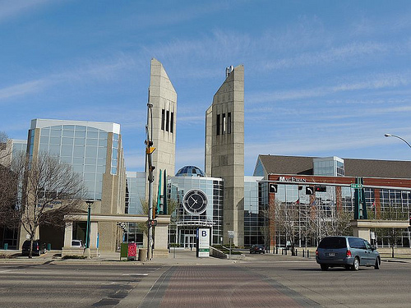
MacEwan Ukrainian Students Club from
MacEwan University, Edmonton, AB.
Representing MUSC at this year's 2017 National SUSK Congress
Alicia Slusarchuk (President)
Stephanie Nedoshytko (Past-President)

Slide 2
In the Fall Semester We:
Meet and Greet w/ Ruslana
Club Days
AGM - elections
Screening of “Searching 4 Opportunities” w/ Oksana Udovyk
UCC-APC Hetman Award- “Empowering the Community”
Holodomor Awareness Week
Witnessed passing of Alberta’s Ukrainian-Canadian Heritage Day Act
Poetry guest Lyuba Yakimchuk

Slide 3
In the Winter Semester We:
Presentation by Dr. Serhiy Kvit on Education Reform in Ukraine
Malanka co-hosted with USS
Student Government Guests from Ukraine
Screening of “This is Gay Propaganda” w/ Marusya Bociurkiw
Pyrohy Palooza
Participate in Global Awareness Week - pysnaky making session
Bitter Harvest Pre-Screening
Drafted a new constitution
Screening of “Hollywood on theDnieper” w/ Svitlana Krys
Another Pyrohy Palooza 2.0
Bake Sale (for HUHTC)
Pysanka Paint Nite
Tshirt Order
HUHTC

Slide 4
Malanka
Our forth and most successful Malanka yet to help ring in the New Year
What was the goal of the event?
Opportunity to raise money for HUHTC and promote the club as well as celebrate the coming of the New Year Ukrainian style
General and Ukrainian community since it was at the Ranch bar
Co-hosted with USS
Millenia performed at it
Ranch was awesome to work with- most of the work and thought
Will be doing again- great feedback

Slide 5
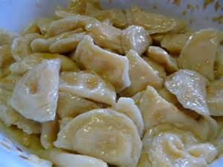
Pyrohy Lunch
1st one to MacEwan
How did you promote it?
Facebook, Email, Instagram, Snapchat
How did you estimate how many people would attend?- asked the U of A and honestly approximated about 80 people
How many people attended?- 67 people attended

Slide 6
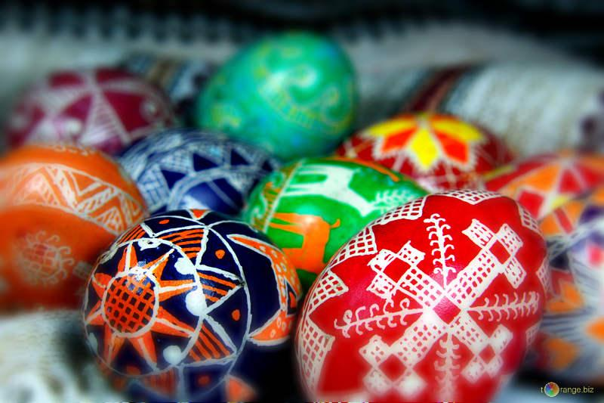
Pysanky Making
What would you change for next time?
Did you receive any feedback?
Did you collect any feedback?
Did you post photos/make a media release after the event?

Slide 7
Biggest Challenges of the Year
What were some of the biggest challenges that your USO faced this year?
Participation
Student’s Association
How did you overcome those challenges?
What would your USO do differently next time?

